Slide 1
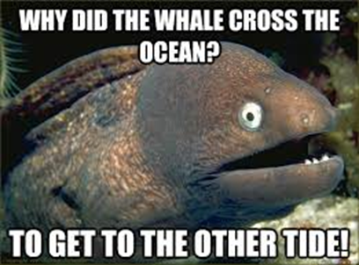
Gravity in the Galaxies Day 3
11/17 & 11/18

Slide 2
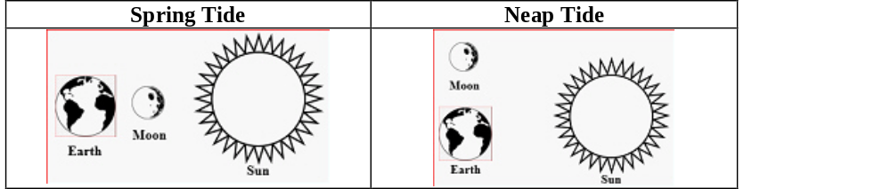

DQ
Spring Tides: refers to the 'springing forth' of the tide during new and full moons. Neap Tides: occurs seven days after a spring tide, refers to a period of moderate tides.
Contrast Spring Tides and Neap Tides, and select the cause and effect choice that correctly explains how these tides are formed. (Select two choices).
A. Neap Tides occur when the Moon and Sun are at right angles to each other, but Spring Tides occur when the Earth, Moon, and Sun are in alignment.
B. Cause: The Moon’s gravity causes the Earth to rotate and revolve. Effect: The Earth’s spinning motion results in ocean bulges called tides.
C. Cause: The Moon’s gravity plus the Sun’s gravity pull on Earth’s oceans. Effect: The oceans bulge upwards creating high and low tides around the planet.
8ESS1.2

Slide 3
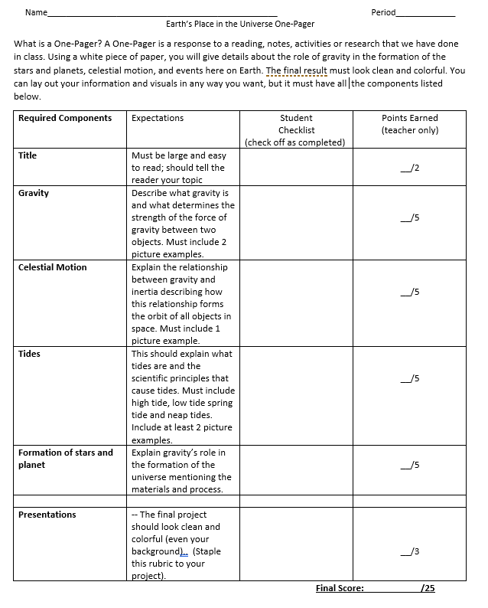
Earth’s Place in the Universe One Pager
8ESS1.2

Slide 4


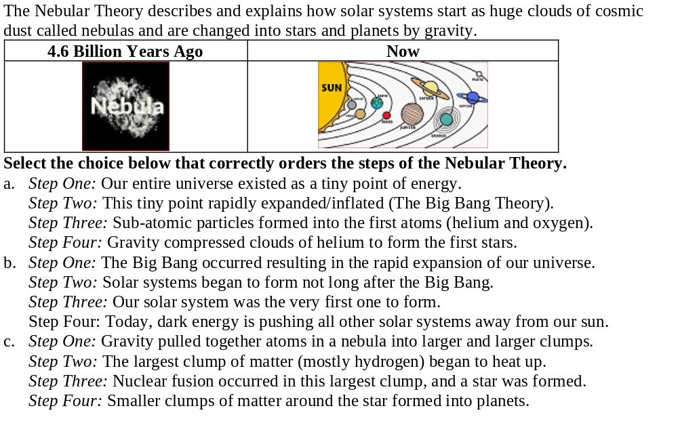
Exit Ticket
8ESS1.2

